Slide 1


Chapter 3
Frame Relay

Slide 2
Introducing Frame Relay
Frame Relay has become the most widely used WAN technology in the world.
Large enterprises, ISPs, and small businesses use Frame Relay, because of its price and flexibility.
Price:
  As corporations grow, so does their dependence on timely, reliable data transport.
  Leased line facilities become expensive.
Flexibility:
  The pace of change and the global nature of businesses demand a flexible, world-wide solution.

Slide 3
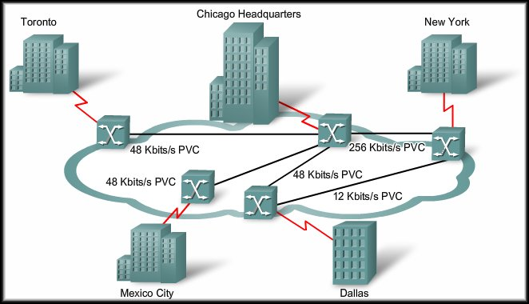
Frame Relay
Basic Frame Relay Concepts

Slide 4
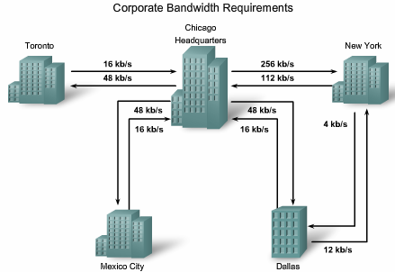
Using the following example…..

Slide 5
Frame Relay: An Efficient and Flexible WAN Technology
Frame Relay has become the most widely used WAN technology in the world.
  Large enterprises, ISPs, and small businesses use Frame Relay, because of its price and flexibility.
Case study: Example of a large enterprise network.
  Chicago to New York requires a speed of 256 kb/s.
  Three other sites need a maximum speed of 48 kb/s connecting to the Chicago headquarters,
  The connection between the New York and Dallas branch offices requires only 12 kb/s.
Using leased lines,
  The Chicago and New York sites each use a dedicated T1 line (equivalent to 24 DS0 channels) to connect to the switch, while other sites use ISDN connections (56 kb/s).
  Because the Dallas site connects with both New York and Chicago, it has two locally leased lines.
  These lines are truly dedicated in that the network provider reserves that line for Span's own use.
Notes:
Use graphic 1.1.1.1
Use graphic 1.1.1.3

Slide 6
Frame Relay: An Efficient and Flexible WAN Technology
Using leased lines,
  You notice a lack of efficiency:
    Of the 24 DSO channels available in the T1 connection, the Chicago site only uses seven.
      Some carriers offer fractional T1 connections in increments of 64 kb/s, but this requires a specialized multiplexer at the customer end to channelize the signals.
    In this case, Span has opted for the full T1 service.
    The New York site only uses five of its 24 DSOs.
    Dallas needs to connect to Chicago and New York, there are two lines through the CO to each site.
Span's Frame Relay network uses permanent virtual circuits (PVCs).
A PVC is the logical path along an originating Frame Relay link, through the network, and along a terminating Frame Relay link to its ultimate destination.
  It provides both cost effectiveness and flexibility.
Notes:
Use graphic 1.1.1.1
Use graphic 1.1.1.3

Slide 7
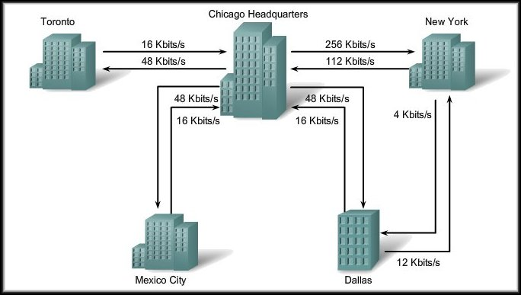
An Efficient and Flexible Technology
Example: Bandwidth Requirements
Need to consider the MAXIMUM.

Slide 8
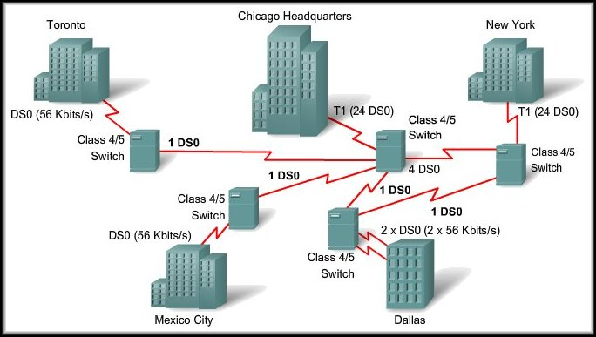
An Efficient and Flexible Technology
Example: Leased Lines
Provider’s
Network

Slide 9
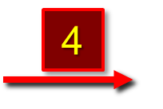
An Efficient and Flexible Technology
Example: Leased Lines
T1 = 24 56K channels
Only use 7 of 24

Slide 10
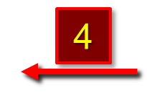
An Efficient and Flexible Technology
Example: Leased Lines
T1 = 24 56K channels
Only use 5 of 24

Slide 11
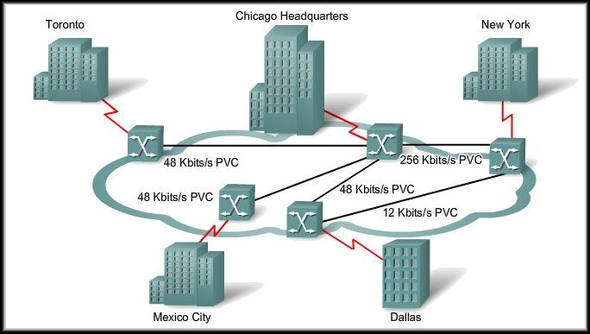
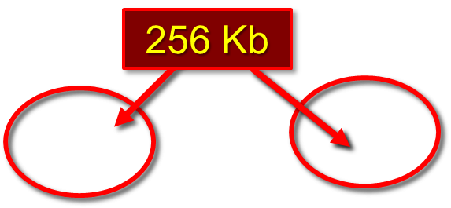
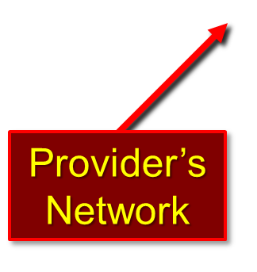
An Efficient and Flexible Technology
Allows multiple links over a single network connection.
Example: Frame Relay
56 Kb

Slide 12
Introducing Frame Relay
Cost Effectiveness:
  Customers only pay for the local loop, and for the bandwidth they purchase from the network provider.
    Distance between nodes is not important.
    With dedicated lines, customers pay for an end-to-end connection. That includes the local loop and the network link.
  Shared bandwidth across a larger base of customers. Typically, a network provider can service 40 or more 56 kb/s customers over one T1 circuit.

Slide 13
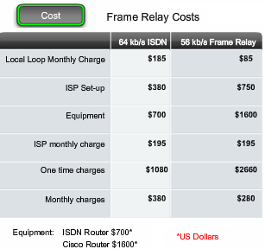
Frame Relay Costs
The table shows a cost comparison for comparable ISDN and Frame Relay.
  The initial costs for Frame Relay are higher than ISDN, the monthly cost is lower.
  Frame Relay is easier to manage than ISDN.
  With Frame Relay, there are no hourly charges.

Slide 14
Frame Relay WAN
When you build a WAN, there are always 3 components,
  DTE
  DCE
  The component that sits in the middle, joining the 2 access points.
In the late 1970s and into the early 1990s, the WAN technology typically used was the X.25 protocol.
  Now considered a legacy protocol.
  X.25 provided a reliable connection over unreliable cabling infrastructures.
  It included additional error control and flow control.

Slide 15
Frame Relay WAN
Frame Relay has lower overhead than X.25 because it has fewer capabilities.
  Modern WAN facilities offer more reliable lines and services.
  Frame Relay does not provide error correction.
  A Frame Relay node simply drops packets without notification when it detects errors.
  Any necessary error correction, such as retransmission of data, is left to the endpoints.
  Frame Relay handles transmission errors through a standard Cyclic Redundancy Check.

Slide 16
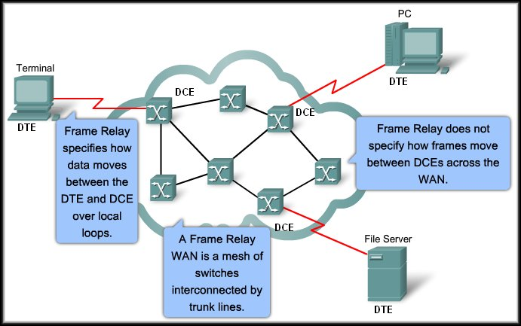
Frame Relay WAN

Slide 17
Frame Relay Operation
Frame Relay DTE to DCE connection:
  Two components:
    Physical Layer:
      Defines the mechanical, electrical, functional, and procedural specifications for the connection.
    Data Link Layer:
      Defines the protocol that establishes the connection between the DTE device (router) and the DCE device (provider’s switch).

Slide 18
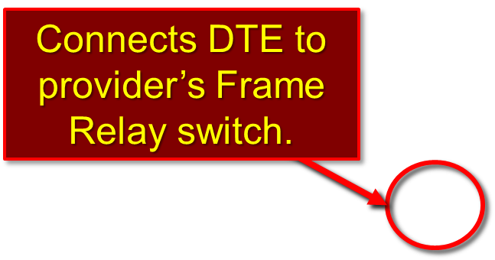
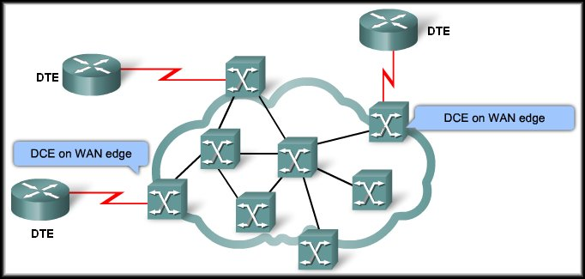
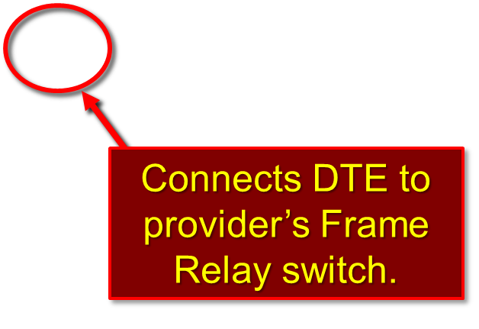
Frame Relay Operation

Slide 19
Virtual Circuits
The connection through a Frame Relay network between two DTEs is called a virtual circuit (VC).
  The circuits are virtual because there is no direct electrical connection from end to end.
  The connection is logical.
  Bandwidth shared among multiple users.
  Any single site can communicate with any other single site without using multiple dedicated physical lines.
Two types:
  Switched (SVC): Dynamic call set up and disappears when done.
  Permanent (PVC): Preconfigured by the provider and always present.

Slide 20
Virtual Circuits
Any single site can communicate with any other single site without using multiple dedicated physical lines.
Toronto
Vancouver
Each site only pays for their connection to the provider’s DCE.
Windsor

Slide 21
Virtual Circuits
VCs are identified by DLCIs.
  (or in English….Virtual Circuits are identified by Data Link Connection Identifiers).
    Permanent Virtual Circuit = PVC.
    Switched Virtual Circuit = SVC.
  DLCI values are assigned by the Frame Relay service provider.
  Frame Relay DLCIs only have local significance.
    The DLCI value itself is not unique in the provider’s Frame Relay WAN.
    It simply identifies a VC to the equipment at an endpoint and is only unique on the physical channel where they reside.

Slide 22
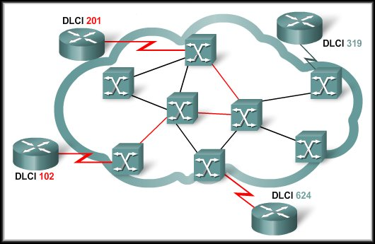
Local Significance of DLCIs
A DLCI simply identifies a VC to the equipment at an endpoint and is only unique on the physical channel where they reside.

Slide 23
Identifying Virtual Circuits (VC)
As the frame moves across the network, Frame Relay labels each VC with a DLCI.
The DLCI is stored in the address field of every frame to tell the network how the frame should be routed.
  The Frame Relay service provider assigns DLCI numbers.
    DLCIs 0 to 15 and 1008 to 1023 are reserved for special purposes.
    Service providers typically assign DLCIs in the range of 16 to 1007.

Slide 24
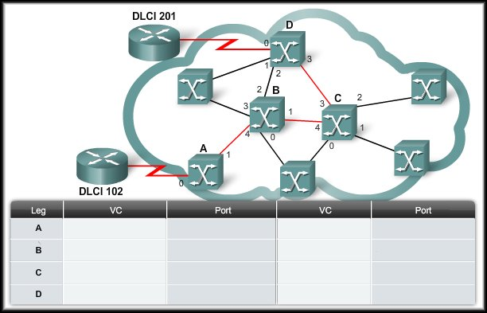
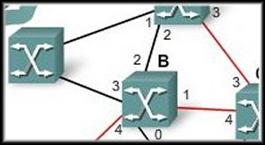
Identifying Virtual Circuits (VC)
VC | Port | DLCI
21 | 0 | 222
22 | 1 | 119
23 | 2 | 309
24 | 3 | 721
25 | 4 | 432
Each Frame Relay switch will have a table that is used to build the virtual circuit.
As the frame moves through the switch, the DLCI is adjusted to follow the predetermined path through the network.

Slide 25
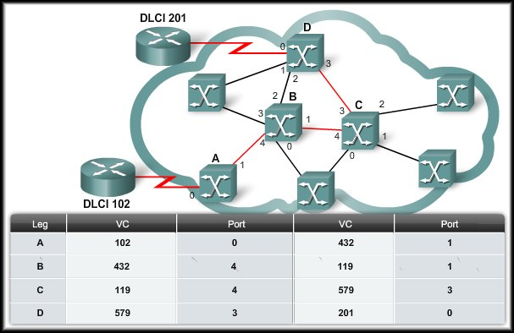
Identifying Virtual Circuits (VC)

Slide 26
Identifying Virtual Circuits (VC)
Any single site can communicate with any other single site without using multiple dedicated physical lines.
Toronto
Vancouver
Windsor | 102 | 119
 | 102 | 432
Toronto | 119 | 102
 | 119 | 432
Vancouver | 432 | 102
 | 432 | 119
Windsor

Slide 27
Multiple Virtual Circuits
Frame Relay is statistically multiplexed.
  It transmits only one frame at a time, but many logical connections can co-exist on a single physical line.
  Multiple VCs on a single physical line are distinguished because each VC has its own DLCI.
  Reduces the equipment and network complexity required to connect multiple devices.
  Cost-effective replacement for a mesh of access lines.
  More savings arise as the capacity of the access line is based on the average bandwidth requirement of the VCs, rather than on the maximum bandwidth requirement.

Slide 28

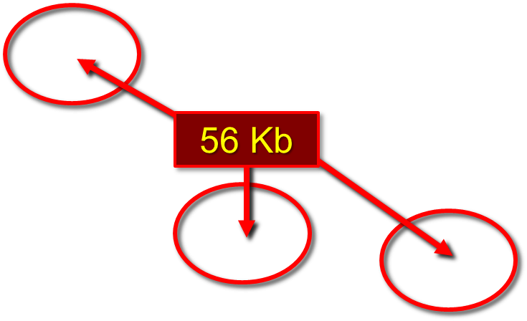
Multiple Virtual Circuits
Capacity based on average bandwidth.
Example: Frame Relay

Slide 29
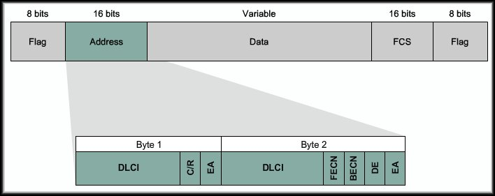
Frame Relay Encapsulation
Frame Relay takes data packets from a network layer protocol and encapsulates them as the data portion of a Frame Relay frame.
DLCI spans 2 bytes

Slide 30
Frame Relay Topologies
A topology is the map or visual layout of the network.
  You need to consider the topology from to understand the network and the equipment used to build the network.
  Every network or network segment can be viewed as being one of three topology types:
    Star (Hub and Spoke)
    Full Mesh
    Partial Mesh

Slide 31
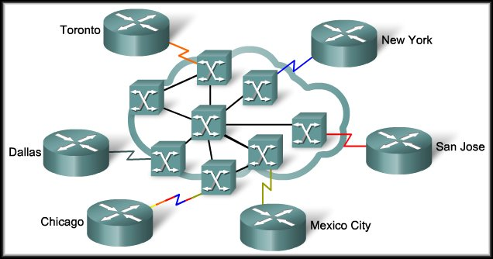
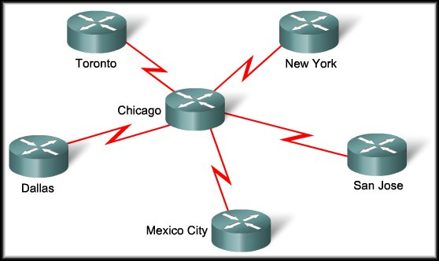
Frame Relay Topologies
Star ( Hub and Spoke):
  The simplest WAN topology.
  A central site that acts as a hub and hosts the primary services.
One site with multiple VCs

Slide 32
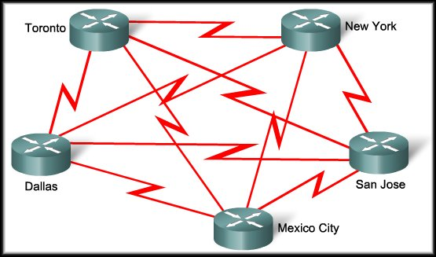
Frame Relay Topologies
Full Mesh:
  A full mesh topology connects every site to every other site. Using leased-line interconnections, additional serial interfaces and lines add costs.
Formula [n(n - 1)]/2
# Sites | # Circuits
2 | 1
3 | 3
4 | 6
5 | 10
6 | 15
7 | 24

Slide 33
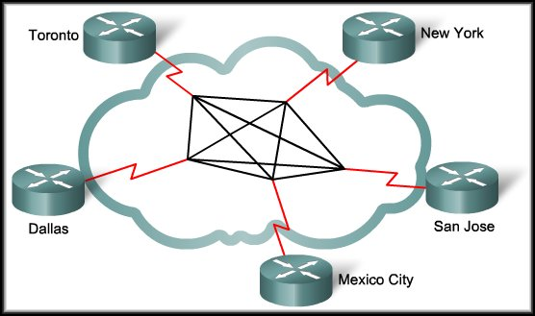
Frame Relay Topologies
Full Mesh:
  Using Frame Relay, a network designer can build multiple connections simply by configuring additional VCs on each existing link.
  No additional
  expense for
  communication
  lines or
  hardware.

Slide 34
Frame Relay Topologies
Partial Mesh:
  For large networks, a full mesh topology is seldom affordable.
  The issue is not with the cost of the hardware, but because there is a theoretical limit of less than 1,000 VCs per link. In practice, the limit is less than that.
  For this reason, larger networks are generally configured in a partial mesh topology.
  With partial mesh, there are more interconnections than required for a star arrangement, but not as many as for a full mesh. The actual pattern is dependant on the data flow requirements.

Slide 35
Configuring Frame Relay
There are two ways of configuring frame relay on a Cisco router.
The first configuration method uses the classic, frame relay nonbroadcast multiaccess (NBMA) model.
In this configuration, the frame relay network is treated as a multiaccess network like a LAN; however, unlike a LAN, a frame relay network has no broadcast capability.
There is no frame relay broadcast address. All of the routers connected to the NBMA network share a network address such as an IP subnet address or an AppleTalk cable range.
The second configuration method involves treating each of the PVCs as a separate logical point-to-point network, which is done by creating a sub interface for each PVC.
The sub interface method requires more network addresses because each PVC has its own network address.

Slide 36
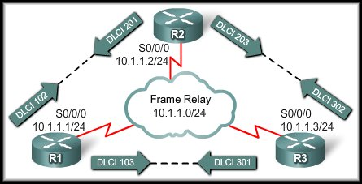
Frame Relay Address Mapping
Before a router is able to transmit data over Frame Relay, it needs to know which local DLCI maps to the Layer 3 address of the remote destination.

Slide 37
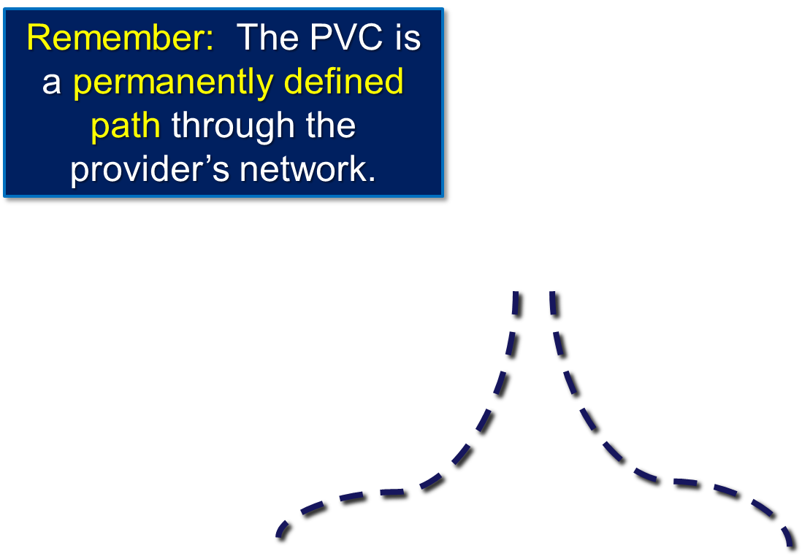
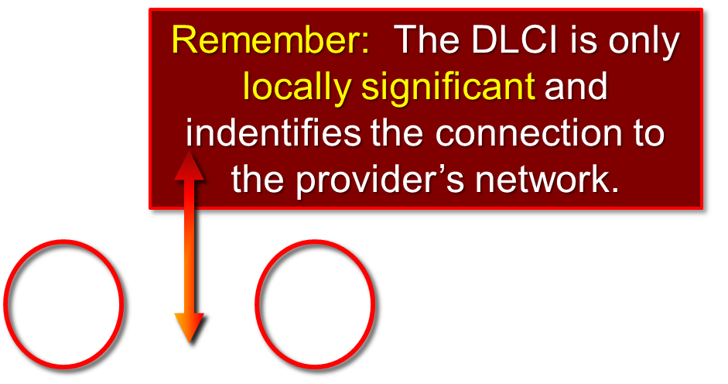
Frame Relay Address Mapping – WHY?
When R2 has a packet to transmit, it must know which DLCI to put in the header at Layer 2.

Slide 38
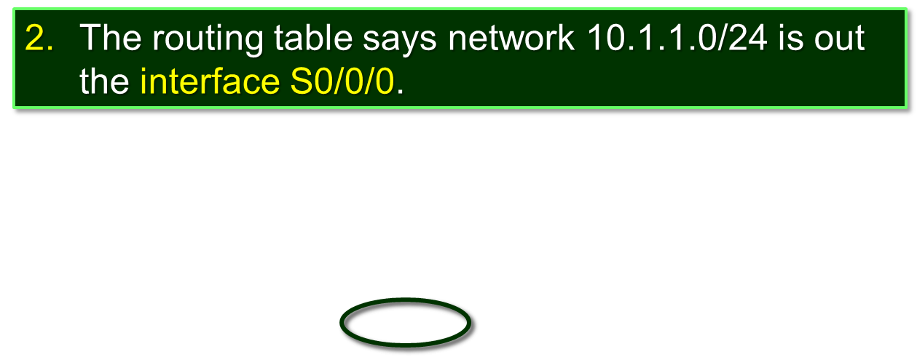
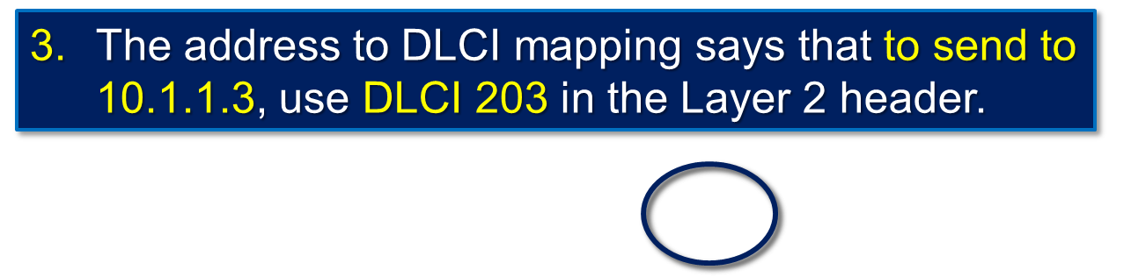
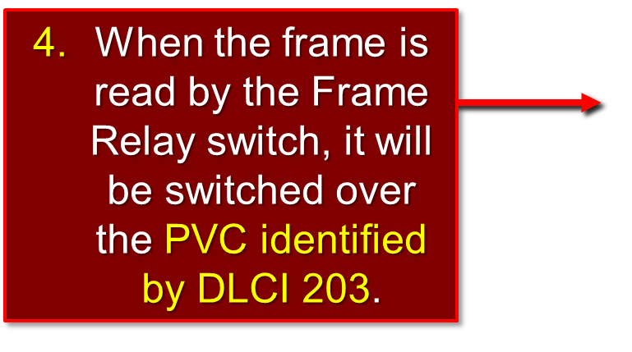
Frame Relay Address Mapping - WHY?
R2 has a packet to transmit to 10.1.1.3.

Slide 39
Frame Relay Address Mapping
Before a router is able to transmit data over Frame Relay, it needs to know which local DLCI maps to the Layer 3 address of the remote destination.
  Two Methods:
    Dynamic Address Mapping.
    Static Address Mapping.

Slide 40
Frame Relay Address Mapping
Dynamic Address Mapping:
  Uses Inverse ARP (IARP).
    ARP: Layer 3 address to obtain Layer 2 address.
    IARP: Layer 2 address to obtain Layer 3 address.
      In the case of Frame Relay, IARP uses the Layer 2 DLCI to obtain the Layer 3 address of the router at the other end of the PVC.
  On Cisco routers, Inverse ARP is enabled by default for only those protocols enabled on the physical interface.

Slide 41
Frame Relay Address Mapping
Static Address Mapping:
  Override Dynamic IARP mapping by supplying a manual static mapping for the next hop protocol address to a local DLCI.
  A static map works associates a specified next hop protocol address to a local Frame Relay DLCI.
    You cannot use Inverse ARP and a map statement for the same DLCI and protocol.
  WHEN?
    The router at the other end of the PVC does not support IARP for the protocol you are using.
    Hub and Spoke Frame Relay.

Slide 42
Local Management Interface (LMI)
History:
  When vendors implemented Frame Relay as a separate technology, they decided that there was a need for DTEs to dynamically acquire information about the status of the network.
  The original design did not include this option.
  A consortium of Cisco, Digital Equipment Corporation (DEC), Northern Telecom, and StrataCom extended the Frame Relay protocol to provide additional capabilities for complex internetworking environments.
  These extensions are referred to collectively as the LMI.

Slide 43
Local Management Interface (LMI)
Basically, the LMI is a keepalive mechanism that provides status information about Frame Relay connections between the router (DTE) and the Frame Relay switch (DCE).
  Every 10 seconds or so, the end device polls the network.
  If the network does not respond with the requested information, the user device may consider the connection to be down.
  When the network responds with a FULL STATUS response, it includes status information about DLCIs that are allocated to that line.
  The end device can use this information to determine whether the logical connections are able to pass data.

Slide 44
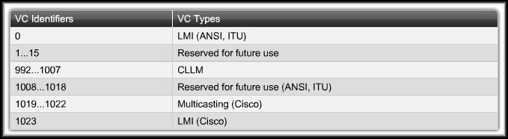
Local Management Interface (LMI)
The 10-bit DLCI field supports 1,024 VC identifiers:
  0 through 1023.
The LMI extensions reserve some of these identifiers, thereby reducing the number of permitted VCs.
  LMI messages are exchanged between the DTE and DCE using these reserved DLCIs.

Slide 45
Local Management Interface (LMI)
There are several LMI types, each of which is incompatible with the others.
  Three types of LMIs are supported by Cisco routers:
    Cisco - Original LMI extension
    Ansi - Corresponding to the ANSI standard T1.617 Annex D
    q933a - Corresponding to the ITU standard Q933 Annex A

Slide 46
Local Management Interface (LMI)
Starting with Cisco IOS software release 11.2, the default LMI autosense feature detects the LMI type supported by the directly connected Frame Relay switch.
  If it is necessary to set the LMI type, use the interface configuration command:
  frame-relay lmi-type [cisco | ansi | q933a]
  Configuring the LMI type, disables the autosense feature.

Slide 47
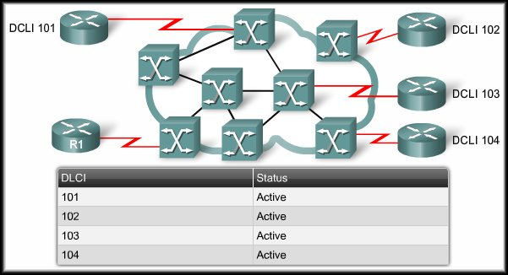
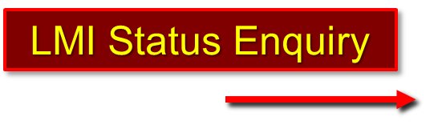
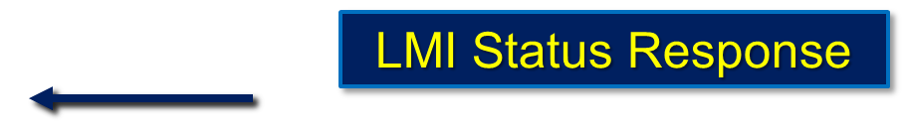
Local Management Interface (LMI)
There will be no connection to the Frame Relay network unless the router and the Frame Relay switch are using the same type of LMI.
For Example:

Slide 48
Frame Relay
Configuring Frame Relay

Slide 49
Configuring Basic Frame Relay
  Set up the IP address on the Interface.
  Configure Frame Relay encapsulation.
    encapsulation frame-relay [cisco | ietf]
    The default encapsulation is Cisco HDLC. Use IETF if connecting to another vendor’s router.
  Set the bandwidth.
    Use the bandwidth command to set the bandwidth for OSPF and EIGRP routing protocols.
  Set the LMI type (optional). (Auto detects the LMI)
  frame-relay lmi-type [cisco | ansi | q833a]

Slide 50
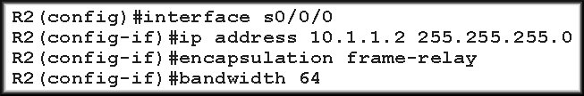
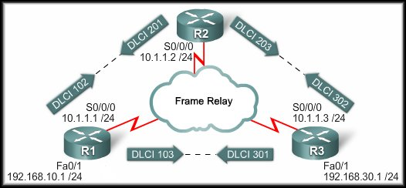
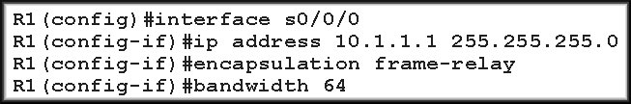
Configuring Basic Frame Relay

Slide 51
Configuring Basic Frame Relay
Once the interfaces are enabled with the no shutdown command:
  The Frame Relay switch and the router exchange LMI status messages that announce the DLCIs to the router.
  IARP maps the remote Layer 3 address to the local DLCI.
  Routers can exchange data.

Slide 52


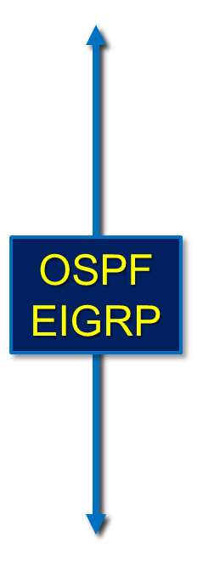

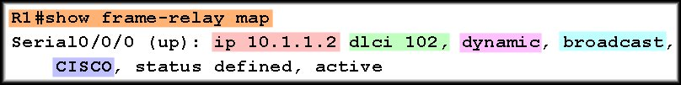
Configuring Basic Frame Relay

Slide 53
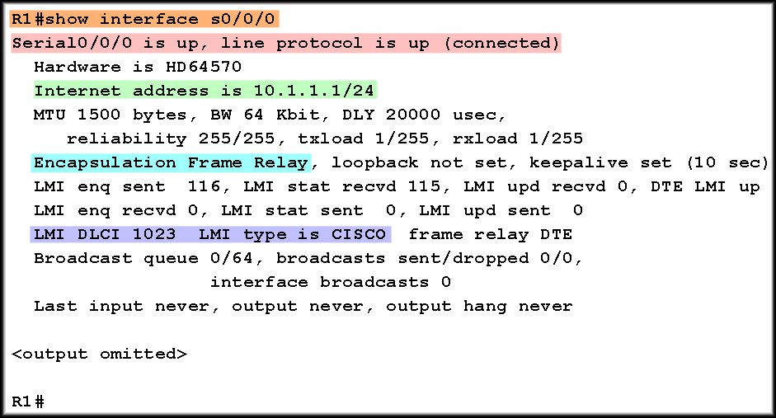
Configuring Basic Frame Relay

Slide 54
Configuring Basic Frame Relay
We used IARP to obtain the DLCI to IP Address mapping.
Remember that IARP only works between point-to-point routers.

Slide 55
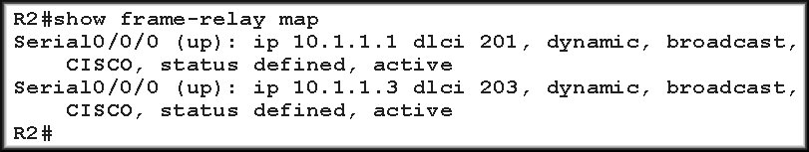
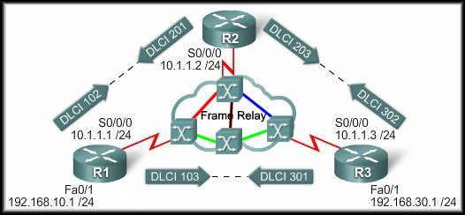
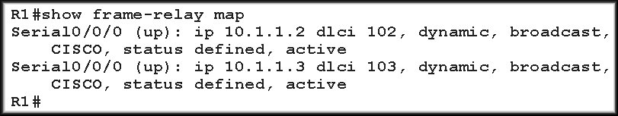
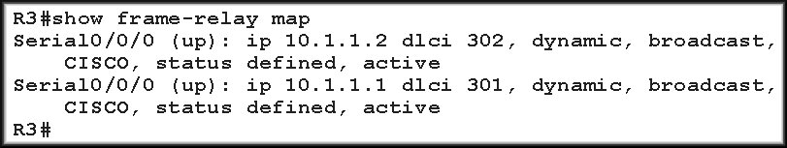
Configuring Basic Frame Relay
PVCs
Full Mesh

Slide 56
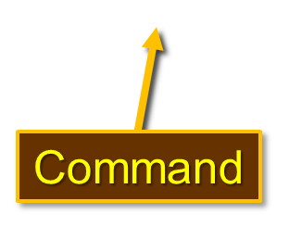
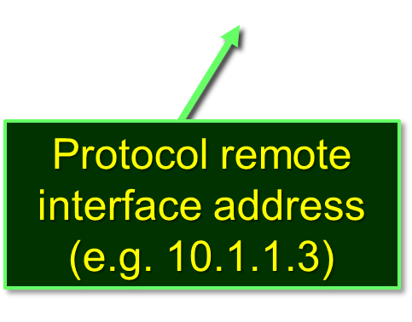
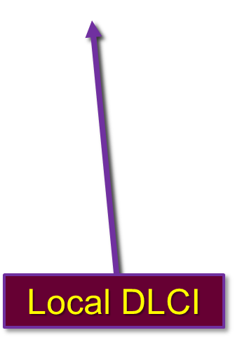
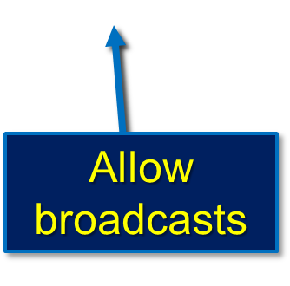
Configuring Static Frame Relay Maps
  To manually map between a next hop protocol address and a DLCI destination address, use the command:
Protocol used on the interface (e.g. IP)

Slide 57
Configuring Static Frame Relay Maps
Frame Relay (and x.25 and ATM) is a non-broadcast multiple access (NBMA) network.
  It does not support multicast or broadcast traffic.
  Using the broadcast keyword is a simplified way to forward routing updates.
    Allows broadcasts and multicasts over the PVC.
  In effect, it turns the broadcast into a unicast do that the other node gets the routing updates.

Slide 58
Configuring Static Frame Relay Maps
When do we use a static map?
  Hub-and Spoke Topology.
  Partial Mesh Topology.
  If you absolutely need a connection between two sites that are already on your Frame Relay network and there is no PVC.
    In other words, turning a site between them into a hub.
      BE CAREFUL!
        Turning a site into a hub can lead to unexpected results if you do not previously plan the new topology! (Trust me – I know!)

Slide 59
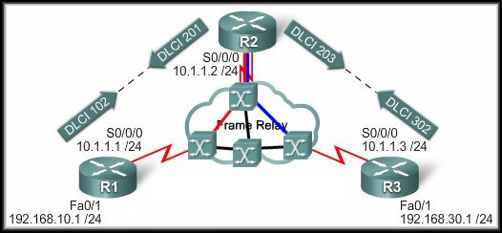

Configuring Static Frame Relay Maps
No PVC between R1 and R3.

Slide 60
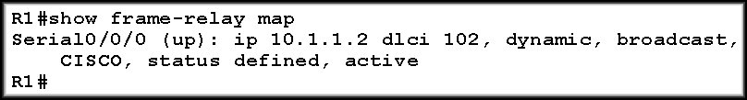

Configuring Static Frame Relay Maps
R1 and R3 know about R2.
R1 and R3 don’t know about each other.
No PVC between R1 and R3.

Slide 61


Configuring Static Frame Relay Maps
How do we fix it?
  Add another PVC to
  the network.
    Additional
    Expense.
  Add a static frame relay map to both R1 and R3.
    R1:
      We will want to map the R3 IP Address 10.1.1.3 to DLCI 102 on R1. Anything for that network should go to the hub.
    R3:
      Map 10.1.1.1 to DLCI 302.

Slide 62
Configuring Static Frame Relay Maps

Slide 63


Configuring Static Frame Relay Maps

Slide 64
Frame Relay
Advanced Frame Relay Concepts

Slide 65
Advanced Frame Relay Concepts
Paying for Frame Relay:
  Access or port speed:
    The cost of the access line from the DTE to the DCE (customer to service provider).
  Permanent Virtual Circuit (PVC):
    This cost component is based on the PVCs.
  Committed Information Rate (CIR):
    Customers normally choose a CIR lower than the port speed or access rate (U.S.).
    This allows them to take advantage of bursts.
    NOTE: There is no CIR in Canada.

Slide 66
Advanced Frame Relay Concepts
Paying for Frame Relay:
  Oversubscription:
    Service providers sometimes sell more capacity than they have on the assumption that not everyone will demand their entitled capacity all of the time.
    Because of oversubscription, there will be instances when the sum of CIRs from multiple PVCs to a given location is higher than the port or access channel rate.
    This can cause traffic issues, such as congestion and dropped traffic.
    Be aware that this can happen!

Slide 67

Advanced Frame Relay Concepts
Bursting:
  Because the physical circuits of the Frame Relay network are shared between subscribers, there will often be time where there is excess bandwidth available.
  Frame Relay can allow customers to dynamically access this extra bandwidth and "burst" over their CIR for free.

Slide 68
Advanced Frame Relay Concepts
Frame Relay Discard Eligibility Bit:
  The frame header also contains a Discard Eligibility (DE) bit, which identifies less important traffic that can be dropped during periods of congestion.
  DTE devices can set the value of the DE bit to indicate that the frame has lower importance than other frames.
  The DE bit is automatically set during a “burst” situation.

Slide 69
Advanced Frame Relay Concepts
Frame Relay Flow Control:
  Frame Relay flow control is a matter of controlling congestion on the frame relay network.
  There are two bits that are set on the frame header when congestion occurs.
    Forward Explicit Congestion Notification (FECN)
    Backward Explicit Congestion Notification (BECN)

Slide 70

Advanced Frame Relay Concepts
Frame Relay Flow Control:
  While Frame Relay Switch A is placing a large frame on interface 1, other frames for this interface are queued.
Traffic Flow

Slide 71

Advanced Frame Relay Concepts
Frame Relay Flow Control:
  When the queue is sent, down stream devices are warned of the queue by setting the FECN bit in the header of the frame that was received on the congested link.
Traffic Flow

Slide 72

Advanced Frame Relay Concepts
Frame Relay Flow Control:
  Upstream devices are warned of the queue by setting the BECN bit in the header of any frames sent on the congested link.
  Each upstream device receives the BECN frame.
Traffic Flow

Slide 73
Advanced Frame Relay Concepts
Frame Relay Flow Control:
  Even though a device may not have contributed to the congestion, it still receives the BECN frame.
  Each device that provides input to the switch is instructed to reduce the rate at which it is sending packets.
Traffic Flow

Slide 74

Solving Reachability Issues
Frame Relay is a Non-Broadcast
Multi-Access (NBMA) network.
  In Ethernet, multiple nodes
  can access the network and
  all nodes see all broadcasts
  or multicasts.
However, in a non-broadcast network such as Frame Relay, nodes cannot see broadcasts of other nodes unless they are directly connected by a virtual circuit.
This means that Branch A cannot directly see the broadcasts from Branch B, because they are connected using a hub and spoke topology.

Slide 75

Solving Reachability Issues
Split Horizon
prohibits routing updates received on an interface from exiting that same interface.
Example:
  The Central router learns about Network X from
  Branch A.
  That update is learned via S0/0.
  The Central router must then send its own update
  to Branch B and Branch C.

Slide 76
Solving Reachability Issues
One Solution is to
turn off split horizon
for IP.
Of course, with split horizon disabled, the protection it affords against routing loops is lost.
Split horizon is only an issue with distance vector routing protocols like RIP and EIGRP.
It has no effect on link state routing protocols like OSPF.
no ip split-horizon

Slide 77

Frame Relay Subinterfaces
A better solution is to use
Subinterfaces.
Subinterfaces are logical
subdivisions of a
physical interface.
In split-horizon routing
environments, routing
updates received on one subinterface can be sent out on another subinterface.
  With this configuration, each PVC can be configured as a point-to-point connection and treated as a separate physical interface – similar to a single leased line.

Slide 78

Frame Relay Subinterfaces
There are two types of Frame Relay subinterfaces:
        Point-to-Point
        Multipoint
How to configure – stay tuned!
Act as a Leased Line.
Separate subnets.
Act as a NBMA so no solution to Split Horizon.
All on the same subnet.

Slide 79

Frame Relay
Configuring Advanced Frame Relay

Slide 80
Configuring Frame Relay Subinterfaces
Configure encapsulation on the interface.
R1(config)#interface serial-number
R1(config-if)#encapsulation frame-relay
R1(config-if)#interface
serial-number.subinterface-number
{multipoint | point-to-point}
R1(config-subif)# frame-relay interface-dlci
dlci-number
Create the sub-interface with the IP Address and any other parameters that apply.
Use this command to map the DLCI to the IP Address – not frame-relay map.

Slide 81
Configuring Frame Relay Subinterfaces
Note that the IP Addressing scheme has changed to provide separate IP subnets for each Frame relay link.
Also note that the DLCI number is used as the sub-interface number.

Slide 82

Configuring Frame Relay Subinterfaces

Slide 83

Configuring Frame Relay Subinterfaces

Slide 84
Configuring Frame Relay Subinterfaces
Configure Frame Relay encapsulation on the interface.
Create a sub-interface for each DLCI on the connection.
  Use the DLCI number – helps in troubleshooting
  Configure the IP address.
  Map the DLCI.
Active the entire interface, not each individual sub-interface.
Use the following commands to verify.
  show frame-relay-map
  show frame-relay lmi
  show frame-relay pvc [dlci-number]
  debug frame-relay lmi

